Slide 1

UFO Sightings in Arizona
Group 1 Final Project

Slide 2
Team Members
Connie Aceves
Angelica Rosario
Jordan Peterson
Katie Bernstein – UFO Extraordinaire

Slide 3
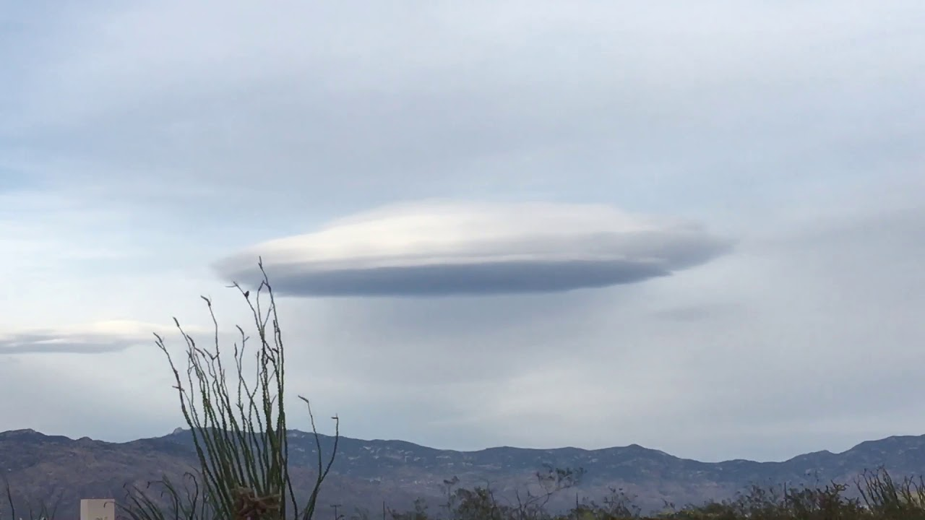
UFO Sightings in Arizona
Arizona has the 7th highest number of UFO sightings in the USA
UFO sightings are a large contributor to Arizona tourism
UFO Conferences are held in Arizona because of the high rate of sightings and interest.
As residents of Arizona, we were interested in learning more about the data
Where the sightings occur
How the volume of sightings might be influenced by the population increase in Arizona over the last 20 years

Slide 4
Progression of the Ultimate “Question”
“Where will the next UFO Sighting occur?”
Data has no Pattern;
Too many errors &
Invalid Sightings
“Does the volume of Sightings increase as Population increases?”
Allows us to focus on UFO reporting
volume, while subsequently cleaning
the city data and comparing the volume to clean population data.

Slide 5
Question
“Do UFO sightings in Arizona increase at the same rate as the city’s population growth in the state of Arizona?”

Slide 6
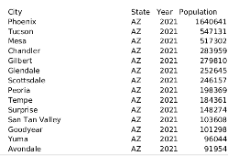
Datasets
 | UFO Sightings (Primary) | AZ City Population
Source | Kaggle | Census Bureau | World Population Review
Data Publisher | National UFO Research Center
Data Topic | UFO Sightings | YoY Population (2000-2019) | YoY Population (2020-2021)
#Columns | 12 | 5 columns | 5 columns
Column Details | Summary: Snip-it of “text” column Date_time: When Sighting took place Shape: Shape of UFO Duration: How long sighting lasted Stats: Time & date of sighting, and when sighting was posted Report_link: Url to actual report Text: Description of sighting Date posted: The date NUFORC posted the report to the site Location of Sighting City State city_latitude city_longitude | City: Name of city State Year: 2000 to 2019 Population | City: Name of city State Year: 2020 to 2021 Population
Original Columns in Dataset:
Notes:
ABOUT

Slide 7
Technology Used:
Dataset ETL/ERD:
Python
Jupyter Notebook
Power Query
Machine Learning Model:
Google Colab – PySpark
Pandas
SKLearn Cluster
Plotly
Matplotlib
HV Plot
Database Creation
PGAdmin: Creating tables and joining tables
SQL Alchemy: Connection String to Python
QuickDBA: ERD Creation
Data Visualization
Power BI

Slide 8
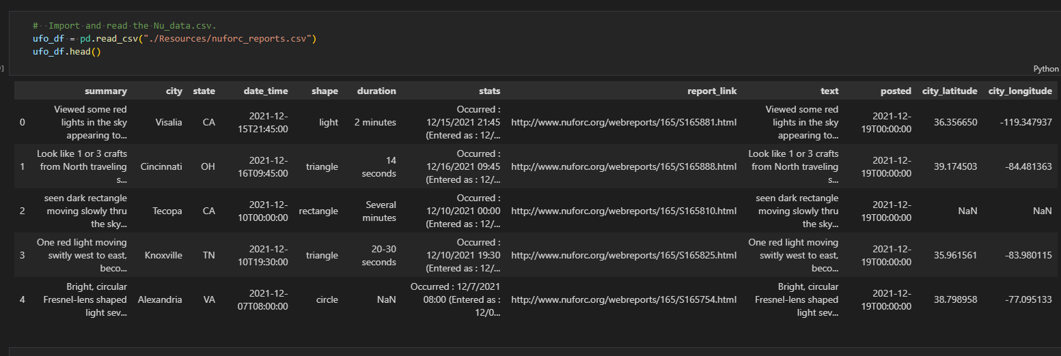
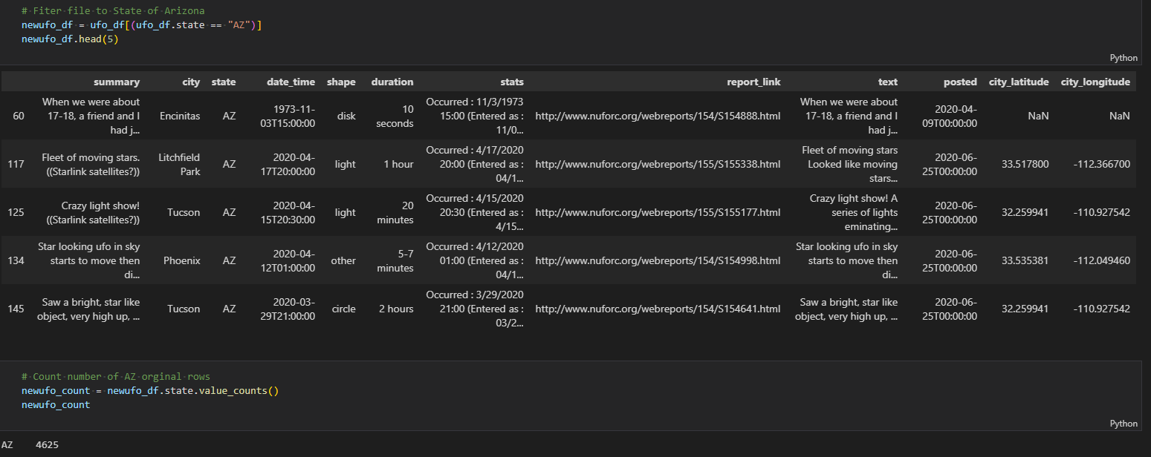
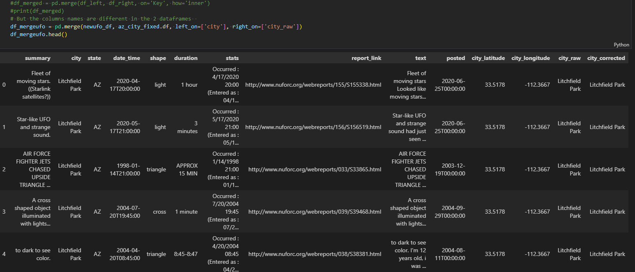
Preparing the Data
Identify Values, Elements of Importance, & Parameters
Determine Parameters & Apply to Dataset
Format & Clean Dataset
Reviewed data quality and identify columns with missing fields or free form fields
Determined which columns will be used for Analysis
Solve for missing data within columns
Remove unnecessary columns
Duration
stats
UFO dataset loaded into pandas dataframe: 1
Pandas dataframe filtered for the state of Arizona:2
Determined Date Range & Location
Filtered Dataset & verified sufficient volume
Pandas loading Arizona city names to correct misspellings,
left merge by city. 3
In the UFO dataset, the city column had substantial errors - Some items were in-fact not cities at all.
Some cities were cities in other states
The date-time column had blanks
Duration column was freeform – No simple way to gather actual duration of sightings
Data transformed and exported: ufo_pop_merge.csv
Notes:
Conclusive Summary:
Data selection entails making good choices about which data will be used. Consider what data is available, what data is missing, and what data can be removed.
Data processing involves organizing the data by formatting, cleaning, and sampling it. In the UFO dataset the cities names had numerous misspellings.
Data transformation entailed loading csv files into python and processed so it could be exported to be used in analysis.

Slide 9
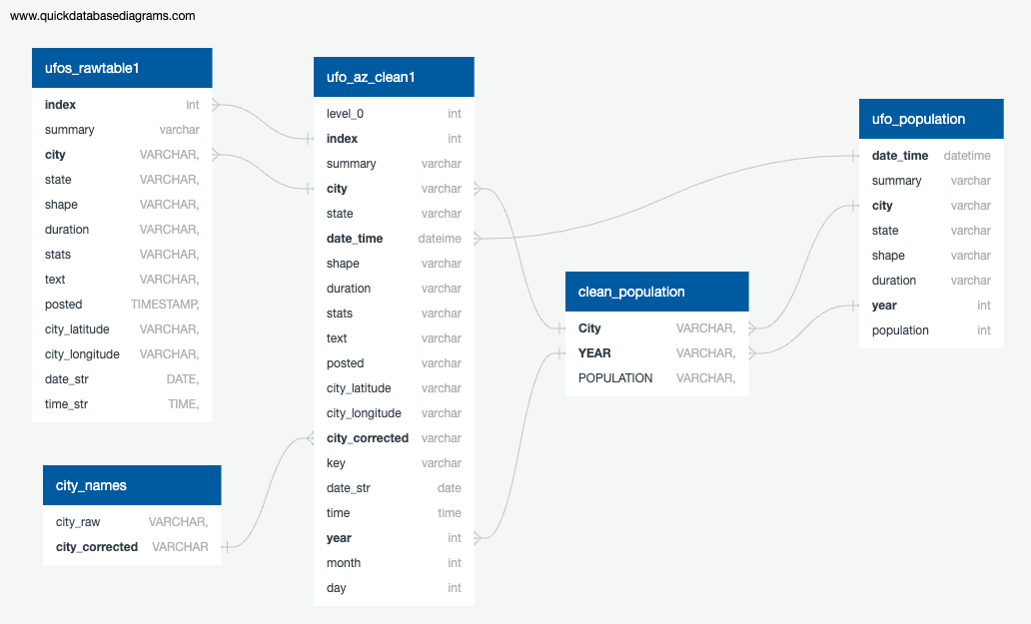
SQL Database Creation
Created database to hold raw data files
Created SQL Alchemy connection to push the tables to Python.
Used the cleaning code that was used in the data preparation phase.
After cleaning was complete, the cleaned data was then pushed backed to PGAdmin as a new table.
City and Population data was then loaded into SQL & joined to the clean data table
The final table (ufo_population) was then ready for export & used for machine learning
Notes:
SQL Database Creation:
The SQL database was a local copy for the purposes of this project – in a real world application,
Amazon Web Services (AWS) could be used to host the database remotely which then all members of a team or group would connect to it via AWS.

Slide 10
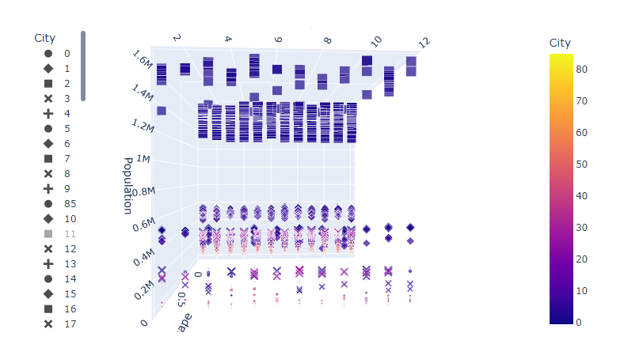
Machine Learning Model
“Do the UFO sightings increase or decrease based on a city’s population?”
The 3D-Cluster model supports our hypothesis:
Cities with larger populations have more sightings throughout a given year.

Slide 11
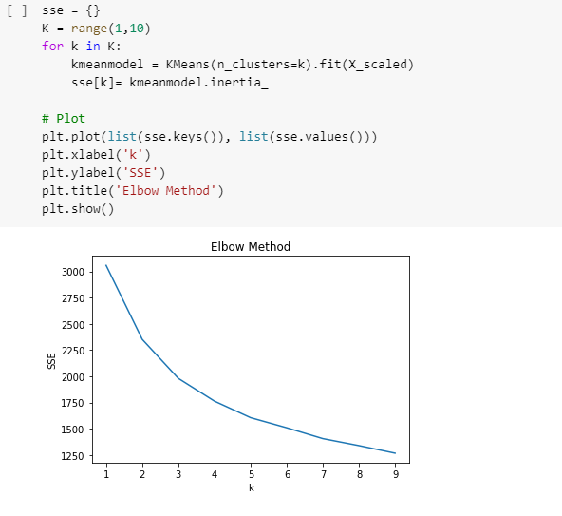
Machine Learning Model
We performed K-Means Clustering to determine the optimal number of clusters to test our dataset.
Based on our ML unsupervised model, our elbow curve is around the 3 mark.
K=3 meaning 3 clusters would be best.

Slide 12
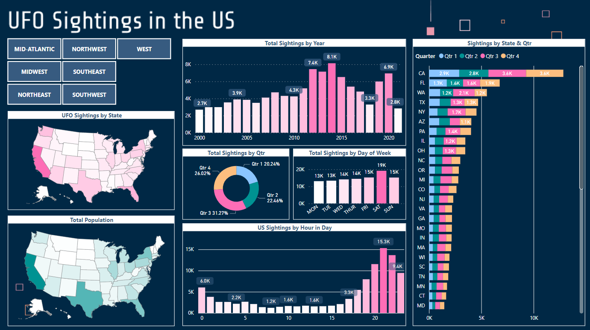

Slide 13
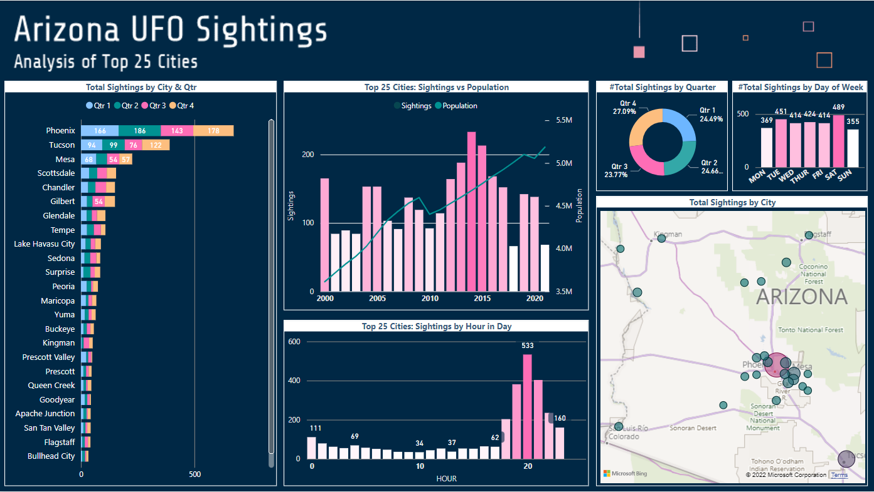

Slide 14
Conclusion
Question
“Do UFO sightings in Arizona increase at the same rate as the city’s population growth in the state of Arizona?”
No, the volume of reported UFO Sightings does not increase at the same rate as Population Growth.
…However, UFO Sightings do occur more frequently in cities with higher populations.

Slide 15
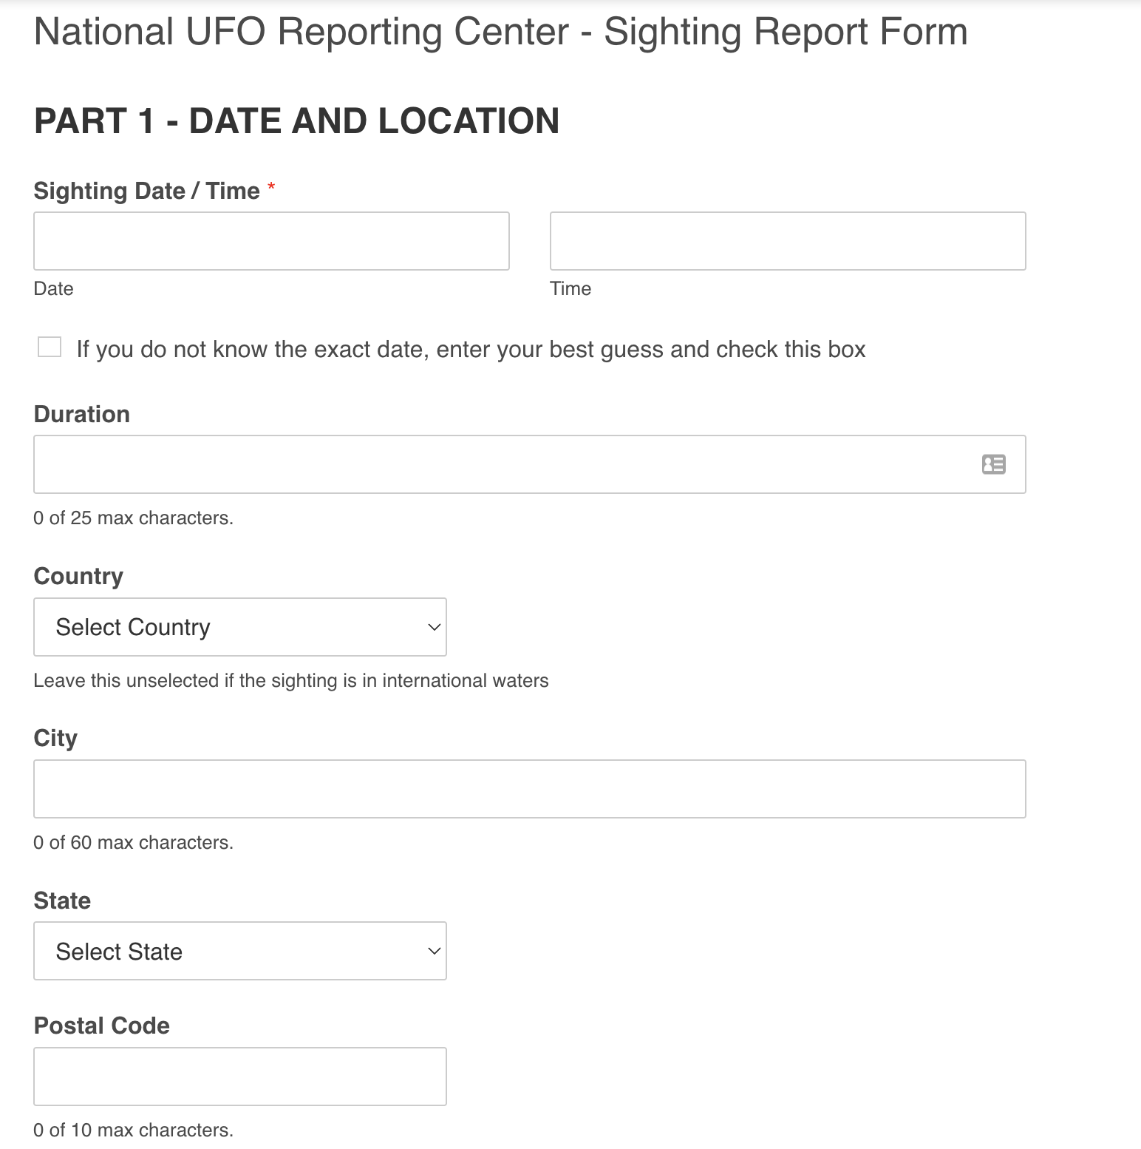
Recommendations for Future Analysis
Deeper Analysis on States that indicates what time of year & day UFO Sightings may occur, based on climate or Weather Patterns
UFO Sighting characteristics by Country
How Economic variables & Pandemics, affect volume of Sightings
National UFO Reporting Center Recommendations:
Less free form answers – more drop down options to reduce the amount of non-sense data or variability in the data.
Sighting Validation – new column or area of data where NUFORC can add their feedback that either approves or denies the sightings. Currently it is listed in the comment box.
Additional Datasets to include:
Locations of Government Testing Sites, Military Bases and other business locations that might effect the data.
Weather Patterns
Satellite & Missile launch Schedule

Slide 16
Project Debrief – Lessons Learned
Select a dataset that has less free form data fields
More conclusive results with machine learning models
Fully understand the Frequency & Accuracy of the Organization’s Auditing Process
When did this Auditing Process Begin?
Does everyone Audit with the Same Method?
There are numerous ways that city & town data can be aggregated – Not all sources go down to the same level of detail or use the same names
EXAMPLES:
Pinetop-Lakeside vs. Pinetop & Lakeside separately
Sightings in National Forests (no population)

Slide 17
Questions?

